Slide 1

Computer- based measuring device
MARIA STOYANOVA AND DESISLAVA BALKANDZHIEVA

Slide 2
What is it?
*It measures 3 physics dimensions - electrical currency, voltage and resistance.
*The results are depicted on a computer. With the use of interface with buttons, the requested dimension is chosen and it's value is being exposed to the user.

Slide 3
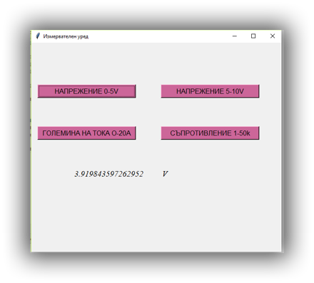
INTERFACE

Slide 4
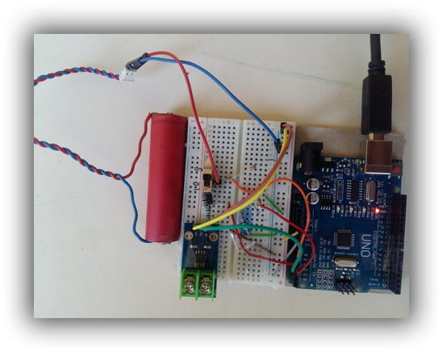
Hardware

Slide 5
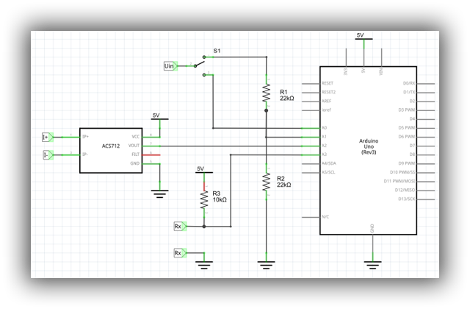
Electrical circuit

Slide 6
Future plans
In future, we'd like to advance our project by adding graphics in real time and the possibility of saving the results

